Slide 1
Team Data Discovery - Logistic Regression Comparison
By: Corey Gates, Nourchene Bargaoui and Bharadwaj Anantha Subramanya

Slide 2
Agenda
Comparison Overview
What is Logistic Regression?
Comparison Approach
Process of Comparison
Results
Our Thoughts

Slide 3
Comparison Overview
The goal of this comparison is to compare Logistic Regression among other models used for the Classification task in Machine Learning.
The other models we will be using for comparison will be The Naive Bayes Classifier, Decision Trees and Support Vector Machine.
We will cover a bit of background behind linear regression for the explanation of logistic regression but linear regression will not be used in our classification comparison since it is not well suited for classification tasks.
Logistic Regression is a popular Supervised learning classification model that uses probability and a threshold value to predict a class given a set of inputs.

Slide 4
Logistic Regression vs. Linear Regression
The main differences between Linear and Logistic Regression deal with the outcome variable in logistic regression which is typically binary vs. in linear regression the outcome variable is continuous as well as the best fit line shapes,
linear (straight) or logistic (S curve).
This differences distinguishes the ideal use cases for each model.
Logistic Regression
Binary Classification of a dependent variable (Yes or No, 1 or 0, True or False)
Linear Regression
Prediction of a continuous dependent variable (Temperature value, etc)

Slide 5
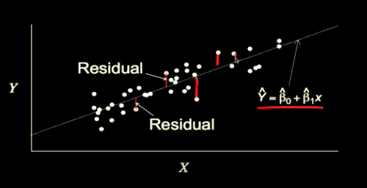
Logistic Regression vs. Linear Regression Continued
Linear Regression: Key Concept:
Least Squares Regression Line
Goal: Create line that fits the data the best
Sum of the absolute value of the residuals = the best fit line (y = mx + b) where b is your prediction. Output or Y is continuous.
We can now use this line
for predictions of continuous
value.

Slide 6
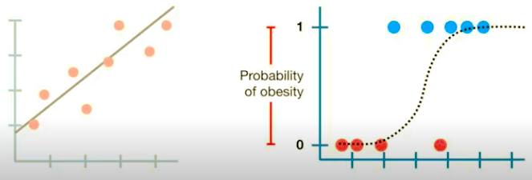
Logistic Regression vs. Linear Regression Continued
Logistic Regression: Key Concept:
Comparison of observed and predicted values based on log - likelihood function (maximum likelihood estimate)
Line of Best Fit is S Curve vs. Straight line (Linear Regression)

Slide 7
Maximum Likelihood Estimate Overview
To explain Maximum Likelihood Estimate , We are going to use sample data from a Mice study which collected size and weight data.
Ex) Left Line - Size (Y) vs Weight (X)
Right Line - Probability of Obesity. Blue - Obese & Red - Not Obese

Slide 8
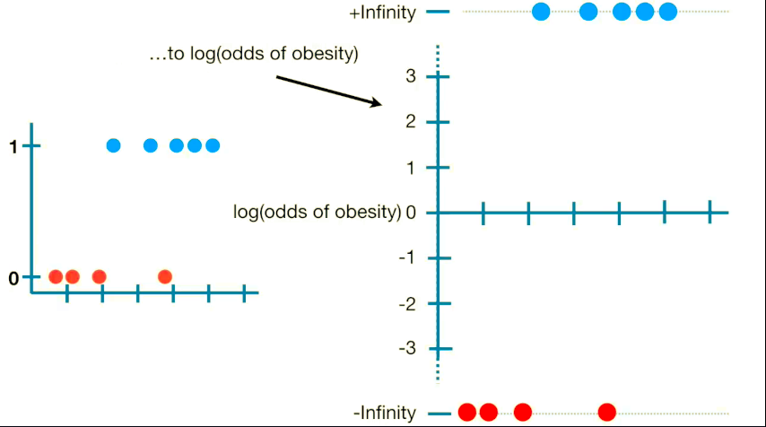
Logistic Regression vs. Linear Regression Continued
Logistic Regression: Transformation of probability of Y to Log Odds (Y)

Slide 9
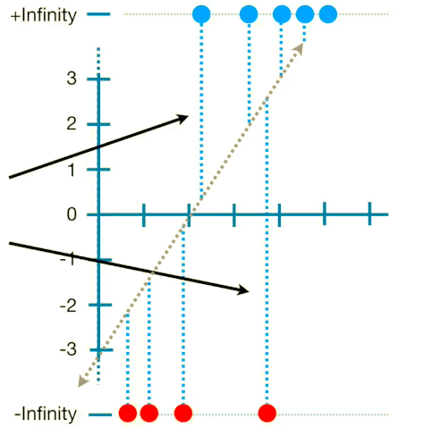
Log Odds Transformation
Transformation pushes data to +/- infinity which in turn makes all the residual distances +/- infinity.
So we can’t use least squares to find
the best fitting line. Instead we use
Maximum Likelihood.

Slide 10
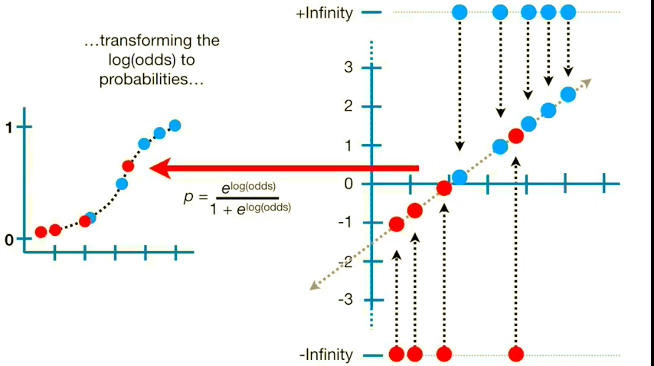
Log Likelihood Sampling
Project original data points onto candidate line.
Calculate the probability using the sigmoid function. Which produces an S Curve.
Then we calculate the
log likelihood for the S-Curve
which gives how well the
S-Curve can predict on the
dataset.
This is repeated iteratively by rotating
the candidate line until the maximum
likelihood is found.

Slide 11
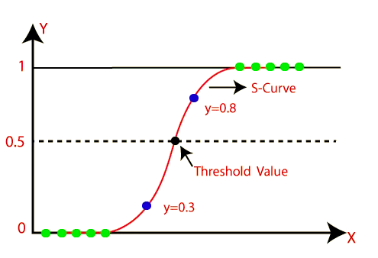
S Curve and Threshold for Prediction
From here you will use the S Curve to tell at a given data point what the probability is. You would then use a threshold value to decide if the data belongs to your positive or negative class.
ex) orange point - input data point
..hits the S curve at point where
the Y value is .8
given our threshold condition
.8 is greater than .5 so the output is 1.
1 - corresponds to the positive class
Red point corresponds to S curve point where Y=0.3
0.3 is lower than the threshold value so output = 0 (negative class)

Slide 12
Bi vs Multi - Classification Problems
So far we’ve seen how logistic regression works with Binary Classification. Can we use Logistic Regression on multi - class problems?
Yes, many implementations exists that have extended the binary logistic regression to handle multiple classes. We will show results from both implementations (binary and multi-class)
In the below article, the researched developed their own in house multi - class logistic regression algorithm from scratch to classify lung cancer risk between low, medium or high. For our purposes we will be using the sklearn logistic regression model which has a parameter which handles binary vs. multi classification preferences.
Referenced Article: Available via VCU Libraries
Rao, Shivaprasad & Bhat P, Mahabaleshwara & Choonthar, Naveena. (2021). Design and Implementation of Multi-class Logistic Regression for Effective Classification of Low, Medium and High Risk Lung Cancer Problem. 10.1007/978-981-16-0443-0_26.

Slide 13
Comparison Approach
What language/ libraries did we use?
We used the Sklearn library for the Naive Bayes Classifier, Decision Trees, Linear Regression, SVM and Logistic Regression. https://scikit-learn.org/stable/modules/generated/sklearn.linear_model.LogisticRegression.html
For Metrics we chose to use Accuracy, F1 Score, Recall and used the Sklearn metrics library. https://scikit-learn.org/stable/modules/model_evaluation.html
Tools: Google Colab

Slide 14
Comparison Approach Continued
The Dataset
Binary Classification
Mushroom Dataset
22 attributes (Categorical)
Output variable - Edible (e) or Poisonous (p)
Multi-Class Classification
Chess (King-Rook vs. King) Dataset
6 attributes (Categorical and Integer)
Output variable - # of moves to win (18 total classes (draw, 0,1… sixteen))
Wine Quality
11 attributes (Real numbers)
Output variable - Quality of Wine based on Attributes (Score: 0,1…10)

Slide 15
Comparison Approach Continued
Scenario:
Use Logistic Regression , SVM , Decision Trees and Naives Bayes on Binary / Multi-Class Datasets
Compare logistic regression with other models
** Sklearn logistic regression model has the ability to detect if the dataset is a binary or multi-class
classification. So we will run Logistic regression on the ‘auto’ setting to cater to handling both binary and multi-class datasets.
Used SkLearn test training split for each dataset - 70% training , 30% testing

Slide 16
The Results Overview
Binary Classification Task Results:
score keys - precision, recall, f1 score and accuracy
Mushroom Dataset:
Decision Tree was 1st with a score of 1 for each metric.
SVM was a very close 2nd with an average of .99 for each metric.
Logistic Regression came in 3rd with an average of .95 for each metric.

Slide 17
The Results Overview Continued
Multi-Class Classification Task Results:
score keys - precision, recall, f1 score and accuracy
Wine Dataset
The multi-class logistic regression model & Naive Bayes showed the best performance with a score of 1 for all metrics .Decision tree was 2nd (.96, .94, .95, .94) and SVM was 3rd (.74, .71, .69, .76)
Chess Dataset
Decision Tree was the best performing model for this dataset with score averages of .84, .83, .83 and accuracy of .83
The other models struggled with this data set.
SVM - .51, .39, .39, .52
Naive Bayes - .29, .27, .19 and .25
Multi-Class Logistic Regression - .26, .23, .22, .28

Slide 18
Our Thoughts?
Importance of pairing the characteristics of the data with the right model.
Requires understanding of both the data and the models you would like to use.
Logistic Regression:
good & approachable supervised learning probabilistic model for classification.
logistic regression model isn’t super complex so the model itself isn't a black box.
good for understanding results
good for extending model for needs (multi-class version)
would still need to ensure data is suitable for the model and use case.

Slide 19
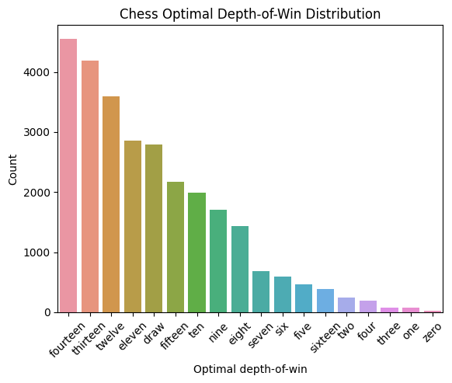
Things we could further explore
Handling Class Imbalance
Chess Dataset was highly imbalance
Opportunity to explore Synthetic data generation techniques to fill minority classes.
Could potentially increase the performance of our models but use of generated data would be based on task domain.
https://bmcmedresmethodol.biomedcentral.com/articles/10.1186/s12874-020-00977-1#citeas

Slide 20
Things we could further explore (cont)
Hyper Parameter Tuning
To test different parameter settings
Sklearn : GridsearchCV (exhaustive search) or RandomizedSearchCV (subset of parameter settings)
Ensures our parameters are optimal within our identified set of parameters (GridsearchCV)
RandomizedSearchCV (also good for evaluating parameters but because it searches a random generated subset of the parameters, your result may not be optimal)
https://www.linkedin.com/pulse/what-gridsearchcv-randomizedsearchcv-differences-between-cheruku

Slide 21
Thank You!

Slide 22
Backup Slides

Slide 23
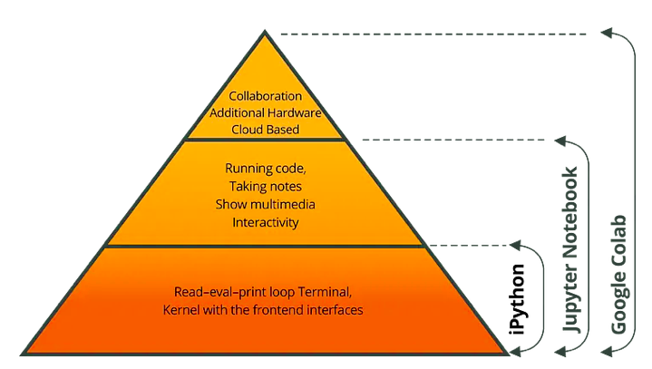
Google Colab

Slide 24
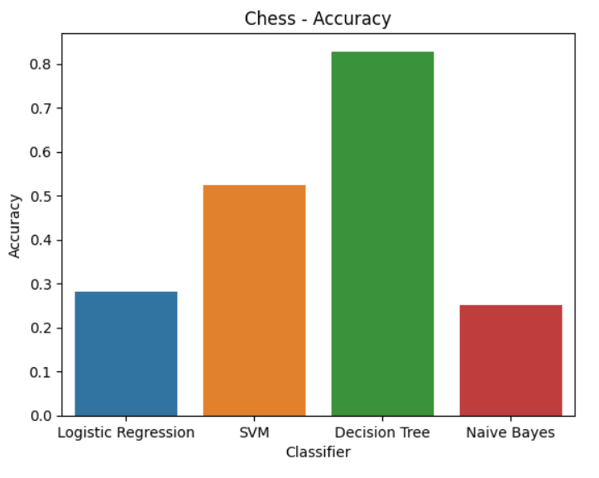
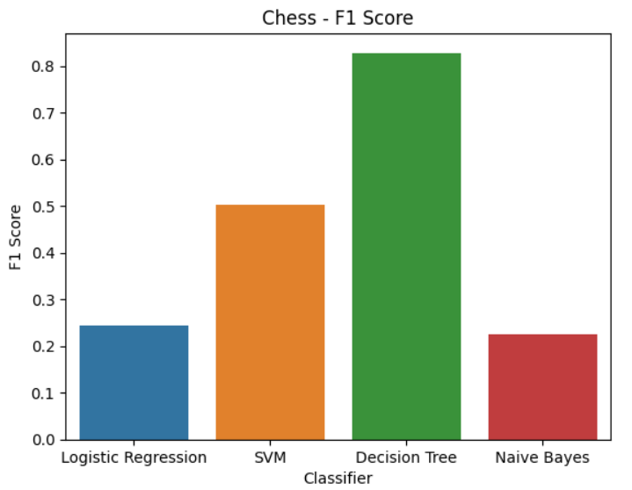
The Results Overview Continued

Slide 25
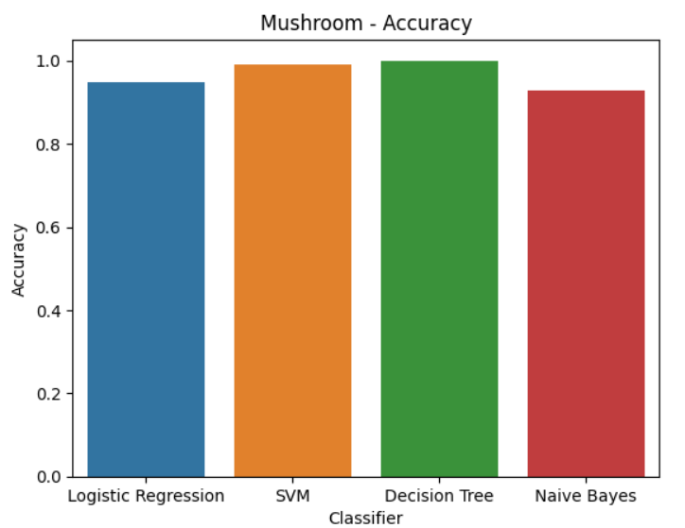
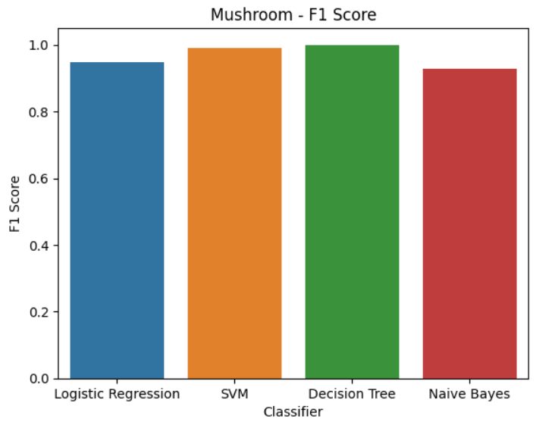
The Results Overview Continued

Slide 26
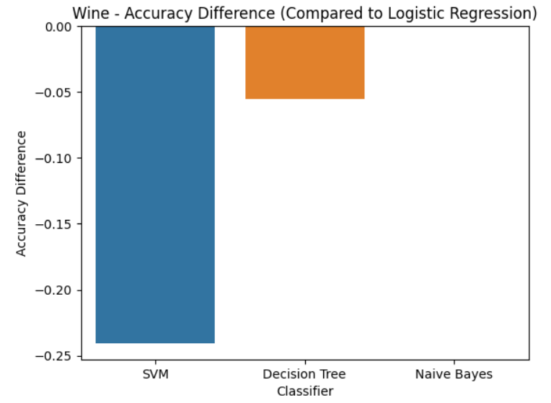
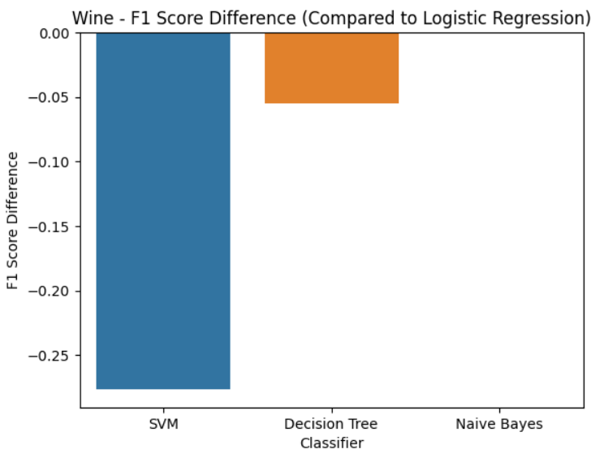
The Results Overview Continued

Slide 27
Supporting References & Documentation
Google Collab Document
https://colab.research.google.com/drive/1jhPXnoTsv4U04bF4eFiOTABPQDN5oGKc?usp=sharing
Experiment Design Document
https://drive.google.com/file/d/1y5bCZL27gHgcPnLFxYwCz2cBdoRbukl9/view?usp=share_link
Hosmer Jr., D.W., Lemeshow, S. and Sturdivant, R.X. (2013) Applied Logistic Regression. 3rd Edition, John Wiley & Sons, Hoboken, NJ.
Goncalves, A., Ray, P., Soper, B. et al. Generation and evaluation of synthetic patient data.BMC Med Res Methodol 20, 108 (2020). https://doi.org/10.1186/s12874-020-00977-1

